Slide 1
Cloud Elevate –Exam Readiness workshop AWS Certified Developer - Associate
Developing and Deepening
Cloud skills @ATCI

Slide 2
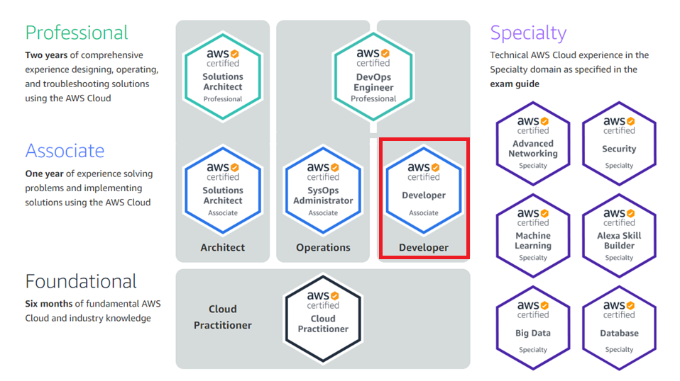
AWS CERTIFICATION PATH
https://aws.amazon.com/certification/
2

Slide 3
AWS Developer - associate
AWS Developer - Associate Exam Guide (Exam Blueprint)
Domain | % of Exam
1: Deployment | 22%
2: Security | 26%
3: Development with AWS | 30%
4: Refactoring | 10%
5: Monitoring and Troubleshooting | 12%
Total | 100%

Slide 4
Refactoring – 10%
Objectives
Optimize application to best use features of AWS
Migrate existing application code to run on AWS

Slide 5
Refactoring
Refactoring is the rewriting, re-architecting, and decoupling of existing applications.
Refactoring is one of the migration strategies that can be implemented for moving application into the cloud. Moving applications into the cloud following a well-architected framework is not a simple process.
Refactoring, you can address these types of questions for migration:
Will the design include a multi-tier architecture or service-oriented architecture?
Will the application migration include an implementation of serverless architecture?
Will there be external or traditional components connecting with the services utilized?
How does refactoring help to implement a well-architected framework?
How do I implement an automated ALC or SDLC according to AWS best practices?
How do I integrate my AWS components as an overall solution?
What tools are available for validation and security of applications migrating to the AWS cloud?
How can I assure users of the application will not experience any downtime during transition to the cloud?
How soon can the architecture and application be rapidly deployed and running on a production environment?

Slide 6
Sample Questions
You are a developer for a company. You have to develop an application which would transfer the logs from several EC2 Instances to an S3 bucket. Which of the following would you use for this purpose?
a. AWS Database Migration Service
b. AWS Athena
c. AWS Data Pipeline
d. AWS EMR

Slide 7
High availability factors
Fault Tolerance
Fault-tolerance is the ability of a system to remain in operation even if some of the components used to build the system fail
Scalability
Scalability refers to the concept of a system in which every application or piece of infrastructure can be expanded to handle increased load.
Recoverability
The process, policies, and procedures related to restoring service after a catastrophic event

Slide 8

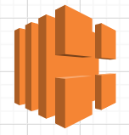
What is elastic load balancer (ELB)?
It is a managed service
Distributes incoming application or network traffic across multiple targets (EC2, containers, and IP addresses) in multiple Availability Zones
Also sends metrics to Amazon Cloud Watch
These metrics helps us to take advantage of Autoscaling to add or remove servers based on the utilization
App
App
App

Slide 9
Elastic Load Balancer Features
High availability
Automatically distributes traffic across multiple targets in a single Availability Zone or multiple Availability Zones
Health checks
Detects unhealthy targets, stops sending traffic to them, and then spread the load across the remaining healthy targets
Security features
Use Amazon VPC to create and manage security groups that are associated with load balancers to provide additional networking and security options
You can also create an internal (non-internet-facing) load balancer

Slide 10
Elastic load Balancer Features
Layer 4 or Layer 7 load balancing
Use layer-7 to load balance HTTP/HTTPS applications and layer-4 to load balance applications that rely on the TCP and UDP protocols.
Operational monitoring
ELB is integrated Amazon CloudWatch metrics and helps to monitor the performance of applications in real time.

Slide 11
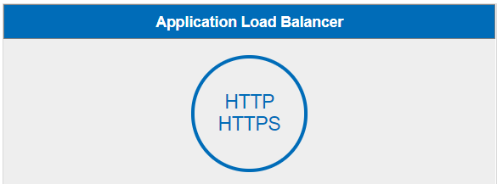
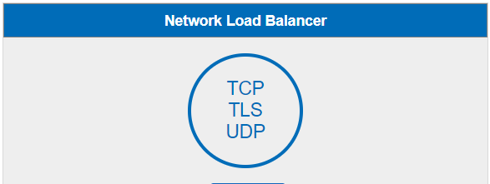
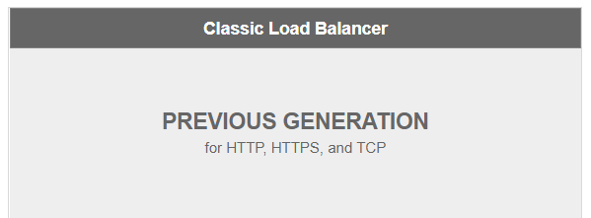
Elastic load Balancer options
Load balance HTTP and HTTPS traffic
Operates at layer – 7
Provides advanced routing features
Support for microservices and containers
Choose when you need ultra-high performance
Support for UDP, and static IP addresses for your application.
Operating at the connection level
Capable of handling millions of requests per second securely while maintaining ultra-low latencies
Choose when you have an existing application running in the EC2-Classic network

Slide 12
EC2 Auto Scaling
Auto Scaling Group
EC2 Auto Scaling has 3 components
Groups: Groups are treated as a logical unit for the purpose of scaling and management
Launch Template or Launch Configuration: Configuration template for EC2 instances
Scaling Options: You can configure a group to scale based on the occurrence of specified conditions (dynamic scaling) or on a schedule
Minimum Size
Scale out as needed
Desired Capacity
Maximum Size

Slide 13
EC2 Auto Scaling
EC2 Auto Scaling
Ensures that correct number of EC2 instances running to handle the load of the application
Auto Scaling Group
Collection of EC2 instances
Minimum Size
Minimum number of instances in each auto scaling group
Maximum Size
Maximum number of instances in each auto scaling group
Desired Capacity
Ensures that your group has specified number of instances
.
Auto Scaling Group
Minimum Size
Scale out as needed
Desired Capacity
Maximum Size

Slide 14



High Availability (Multi-AZ) for Amazon RDS
Amazon RDS Multi-AZ deployments provides high availability and failover support for DB instances
In a Multi-AZ deployment, Amazon RDS automatically provisions and maintains a synchronous standby replica in a different Availability Zone.
RDS Master
Availability Zone A
RDS Standby Replica
Availability Zone B
Synchronous Replication
AWS Region

Slide 15
Sample Questions
You are a developer for a company. You have to develop an application which would transfer the logs from several EC2 Instances to an S3 bucket. Which of the following would you use for this purpose?
a. AWS Database Migration Service
b. AWS Athena
c. AWS Data Pipeline
d. AWS EMR

Slide 16
Sample Questions
You are a developer for a company. You have to develop an application which would transfer the logs from several EC2 Instances to an S3 bucket. Which of the following would you use for this purpose?
a. AWS Database Migration Service
b. AWS Athena
c. AWS Data Pipeline
d. AWS EMR

Slide 17
Sample Questions
You’ve been asked to move an existing development environment on the AWS Cloud. This environment consists mainly of Docker based containers. You need to ensure that minimum effort is taken during the migration process. Which of the following step would you consider for this requirement?
a. Create an Opswork stack and deploy the Docker containers
b. Create an application and Environment for the Docker containers in the Elastic Beanstalk service
c. Create an EC2 Instance. Install Docker and deploy the necessary containers.
d. Create an EC2 Instance. Install Docker and deploy the necessary containers. Add an Autoscaling Group for scalability of the containers

Slide 18
Sample Questions
You’ve been asked to move an existing development environment on the AWS Cloud. This environment consists mainly of Docker based containers. You need to ensure that minimum effort is taken during the migration process. Which of the following step would you consider for this requirement?
a. Create an Opswork stack and deploy the Docker containers
b. Create an application and Environment for the Docker containers in the Elastic Beanstalk service
c. Create an EC2 Instance. Install Docker and deploy the necessary containers.
d. Create an EC2 Instance. Install Docker and deploy the necessary containers. Add an Autoscaling Group for scalability of the containers

Slide 19
Sample Questions
You’ve been asked to move an existing development environment on the AWS Cloud. This environment consists mainly of Docker based containers. You need to ensure that minimum effort is taken during the migration process. Which of the following step would you consider for this requirement?
a. Create an Opswork stack and deploy the Docker containers
b. Create an application and Environment for the Docker containers in the Elastic Beanstalk service
c. Create an EC2 Instance. Install Docker and deploy the necessary containers.
d. Create an EC2 Instance. Install Docker and deploy the necessary containers. Add an Autoscaling Group for scalability of the containers

Slide 20
Sample Questions
Your team is currently working on a source code that’s defined in a Subversion repository. The company has just started using AWS tools for their CI/CD process and has now mandated that source code be migrated to CodeCommit. Which of the following steps would you perform to fulfill this requirement? Choose 2 answers from the options given below.
a. Migrate the code as it is to the AWS Code Commit Repository
b. Migrate the code to a Git Repository first
c. Migrate code from Git to AWS Code Commit
d. Ensure to clone the current repository before committing it to AWS Code Commit

Slide 21
Sample Questions
Your team is currently working on a source code that’s defined in a Subversion repository. The company has just started using AWS tools for their CI/CD process and has now mandated that source code be migrated to CodeCommit. Which of the following steps would you perform to fulfill this requirement? Choose 2 answers from the options given below.
a. Migrate the code as it is to the AWS Code Commit Repository
b. Migrate the code to a Git Repository first
c. Migrate code from Git to AWS Code Commit
d. Ensure to clone the current repository before committing it to AWS Code Commit

Slide 22
Sample Questions
Your team is currently working on a source code that’s defined in a Subversion repository. The company has just started using AWS tools for their CI/CD process and has now mandated that source code be migrated to CodeCommit. Which of the following steps would you perform to fulfill this requirement? Choose 2 answers from the options given below.
a. Migrate the code as it is to the AWS Code Commit Repository
b. Migrate the code to a Git Repository first
c. Migrate code from Git to AWS Code Commit
d. Ensure to clone the current repository before committing it to AWS Code Commit

Slide 23
Sample Questions
Your team is transitioning a stateful based web application to AWS. You need to decide the services which will be used to host the application. Which of the following would be included in the design? Choose 2 answers from the options given below
a. DynamoDB to store the session data
b. AWS Lambda to store the session data
c. An Application Load balancer to distribute traffic
d. An API gateway to distribute traffic

Slide 24
Sample Questions
Your team is transitioning a stateful based web application to AWS. You need to decide the services which will be used to host the application. Which of the following would be included in the design? Choose 2 answers from the options given below
a. DynamoDB to store the session data
b. AWS Lambda to store the session data
c. An Application Load balancer to distribute traffic
d. An API gateway to distribute traffic

Slide 25
Sample Questions
Your team is transitioning a stateful based web application to AWS. You need to decide the services which will be used to host the application. Which of the following would be included in the design? Choose 2 answers from the options given below
a. DynamoDB to store the session data
b. AWS Lambda to store the session data
c. An Application Load balancer to distribute traffic
d. An API gateway to distribute traffic

Slide 26
Sample Questions
Your development team is testing out an application that is being deployed onto AWS Elastic Beanstalk. The application needs to have an RDS Instance provisioned as part of the Elastic Beanstalk setup and they also want to ensure that the database is preserved for analysis even after the environment is torn down. How can you achieve both the requirements? Choose 2 answers from the options given below
a. Ensure the database is created as part of the Elastic Beanstalk environment.
b. Ensure that you only choose the MySQL engine type
c. Ensure that the retention for the database is marked as “Create Snapshot”
d. Ensure that the retention for the database is marked as “Automated Backup”

Slide 27
Sample Questions
Your development team is testing out an application that is being deployed onto AWS Elastic Beanstalk. The application needs to have an RDS Instance provisioned as part of the Elastic Beanstalk setup and they also want to ensure that the database is preserved for analysis even after the environment is torn down. How can you achieve both the requirements? Choose 2 answers from the options given below
a. Ensure the database is created as part of the Elastic Beanstalk environment.
b. Ensure that you only choose the MySQL engine type
c. Ensure that the retention for the database is marked as “Create Snapshot”
d. Ensure that the retention for the database is marked as “Automated Backup”

Slide 28
Sample Questions
Your development team is testing out an application that is being deployed onto AWS Elastic Beanstalk. The application needs to have an RDS Instance provisioned as part of the Elastic Beanstalk setup and they also want to ensure that the database is preserved for analysis even after the environment is torn down. How can you achieve both the requirements? Choose 2 answers from the options given below
a. Ensure the database is created as part of the Elastic Beanstalk environment.
b. Ensure that you only choose the MySQL engine type
c. Ensure that the retention for the database is marked as “Create Snapshot”
d. Ensure that the retention for the database is marked as “Automated Backup”

Slide 29
Happy Learning!!
29

